Slide 1
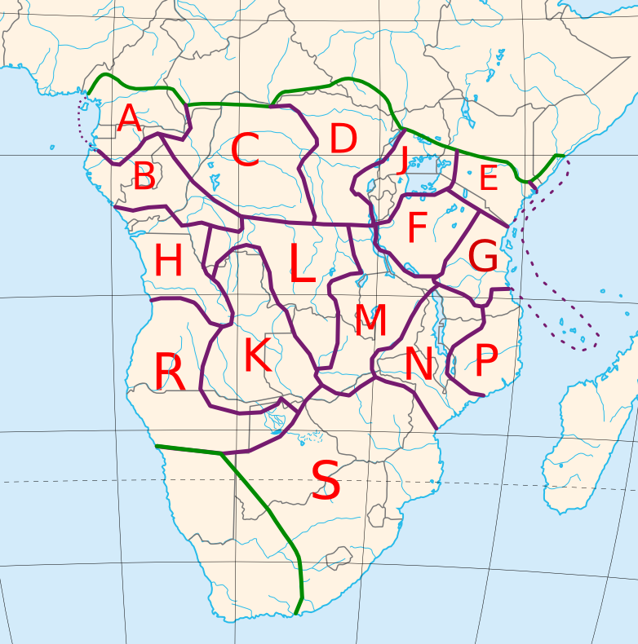

Slide 2
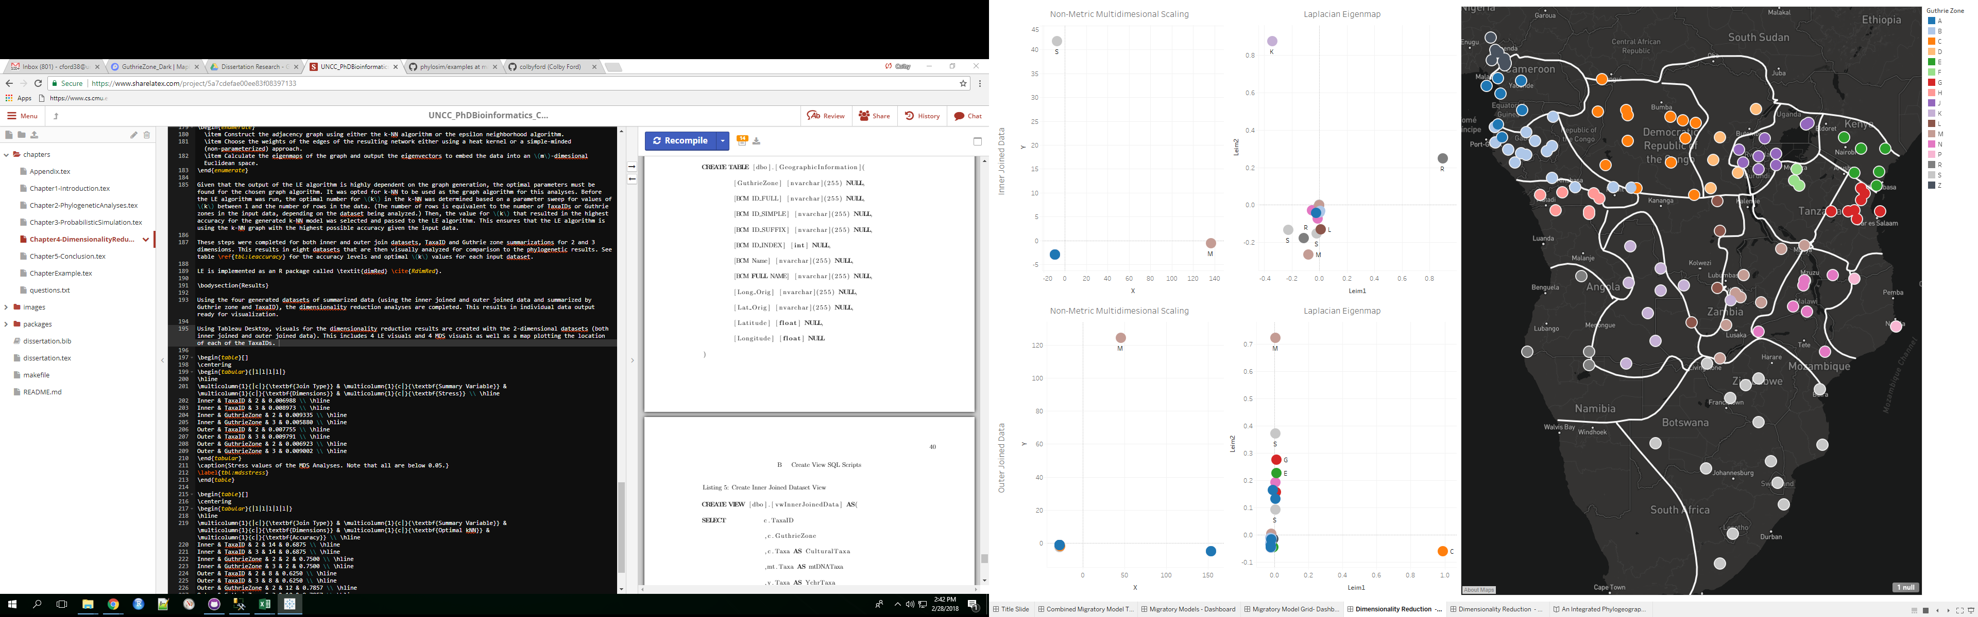


Slide 3
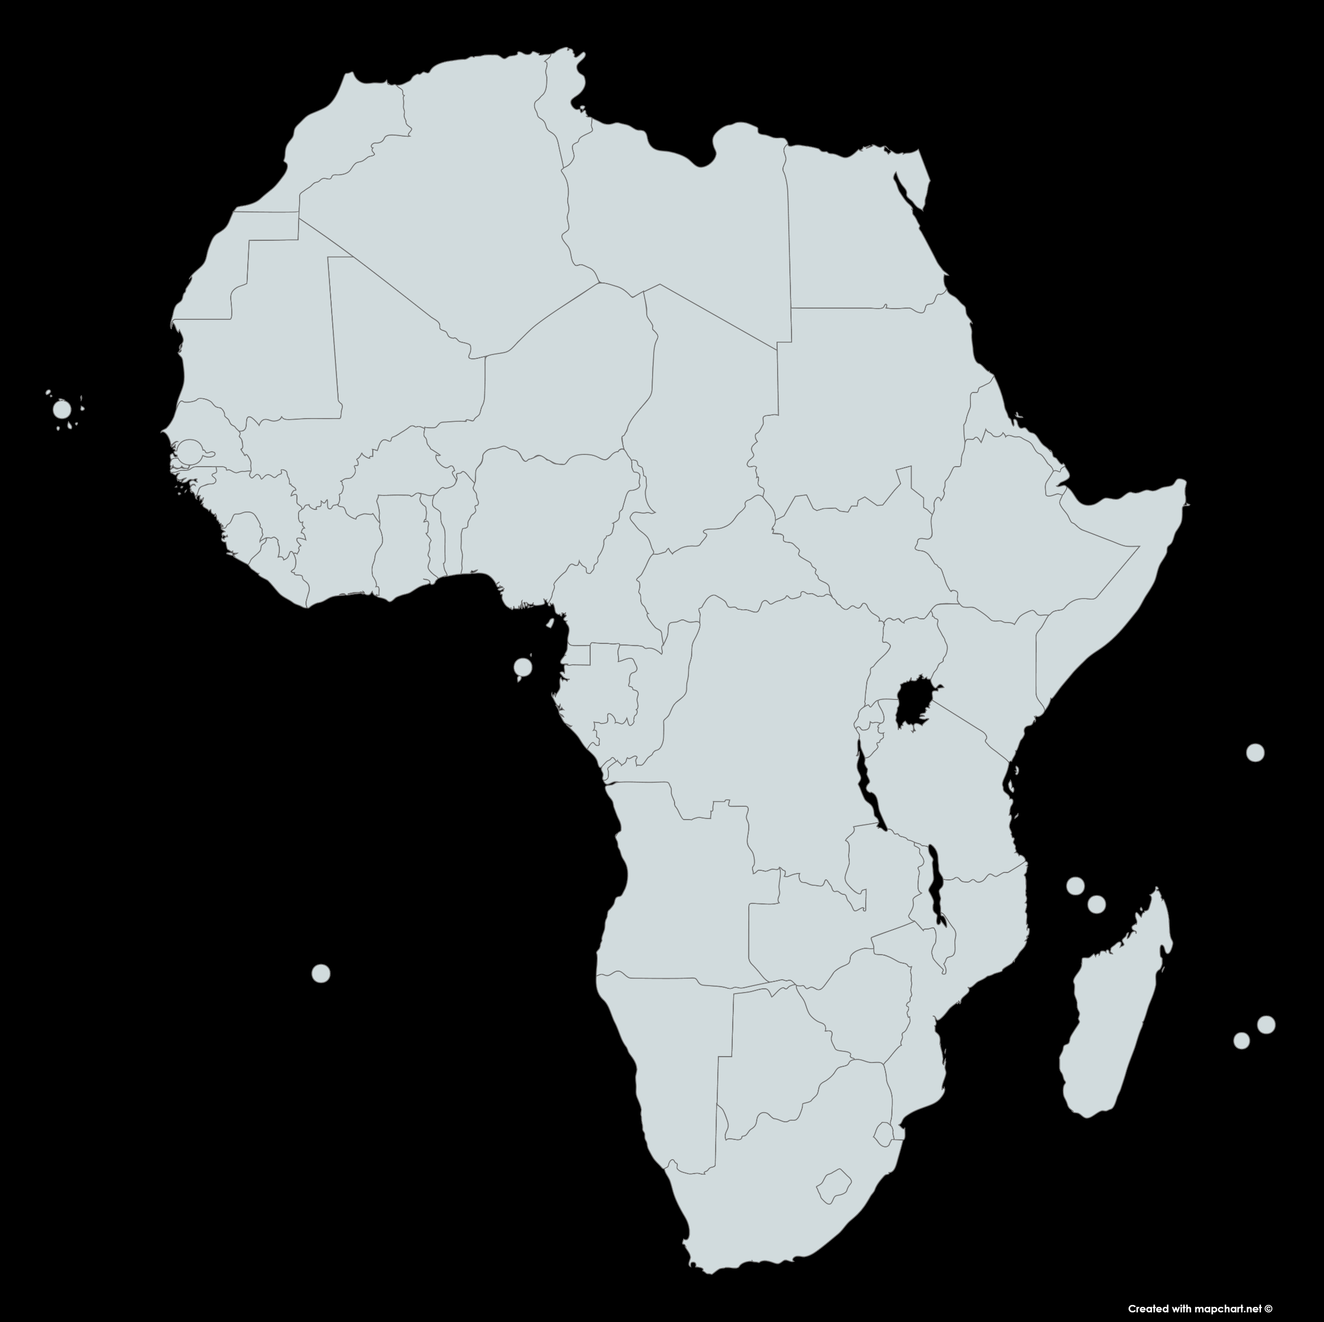

Slide 4
A
N
NW
NE
W
E
B
SW
SE
S
H
Migration Direction
C
J
F
G
E
D
K
R
L
N
P
M
S

Slide 5
A
N
NW
NE
B
W
Migration
Direction
E
SW
SE
S
H
C
J
F
G
E
D
K
R
L
N
P
M
S

Slide 6
mtDNA | Example
TaxaID | H31Yaka
GuthrieZone | H
Taxa | H31Yaka_BiakaPygmy_NA_mt01
BCMID | H31
SampleID | mt01
mtDNA | gatcacaggtctatcacccta…
Ychr | Example
TaxaID | A34Benga
GuthrieZone | A
Taxa | A34Benga_Benga_Gabon_chry01
BCMID | A34
SampleID | chry01
Ychr_STR | EJGJBPDBFEBB
Cultural | Example
TaxaID | A242Duala
GuthrieZone | A
Taxa | A242Duala
BCMID | A24 2
Cultural_EthnogAtlas | 0101818559189B293919997…
Geographic Information | Example
GuthrieZone | B
BCM ID_FULL | B80L1
BCM ID_SIMPLE | B80
BCM ID_SUFFIX | L1
BCM ID_INDEX | 1
BCM NAME | Lwel 1
BCM FULL NAME | B80L1Lwel 1
Longitude | -4.45
Latitude | 20.1

Slide 7
❶ Load data from SQL tables using view
TaxaID | … | mtDNA | Ychr_STR | Cultural_EthnogAtlas
A751Fang | … | gatcag…gct | DHHKANEBGEBC | 2231618755185B6…
❷ Split sequence strings and assign each letter to its own variable
TaxaID | … | mtDNA.pos1 | … | mtDNA.pos16590 | Ychr_STR.pos1 | …
A751Fang | … | g | … | t | D | …
❸ Dummy code the data into 1’s and 0’s
TaxaID | … | mtDNA.pos1.g | mtDNA.pos1.c | … | Ychr_STR.pos1.D | …
A751Fang | … | 1 | 0 | … | 1 | …
❹ Collapse table to summarize by TaxaID or Guthrie zone
GuthrieZone | … | mtDNA.pos1.g | mtDNA.pos1.c | … | Ychr_STR.pos1.D | …
A | … | 0.444444444 | 0.555556 | … | 0.999991 | …
❺ Perform dimensionality reduction and output new coordinates of the zones
GuthrieZone | Coordinate i | … | Coordinate j
A | 20.13001 | … | 1.39884

Slide 8












Input Data
Tree Generation
Model Output
Y-chromosomal STR
POY4
PAUP
.nexus
.tree
Mitochondrial DNA
MAFFT
POY4
PAUP
.fasta
.fasta
.tree
Cultural
POY4
PAUP
.nexus
.tree
Combined
POY4
PAUP
.nexus
.tree

Slide 9
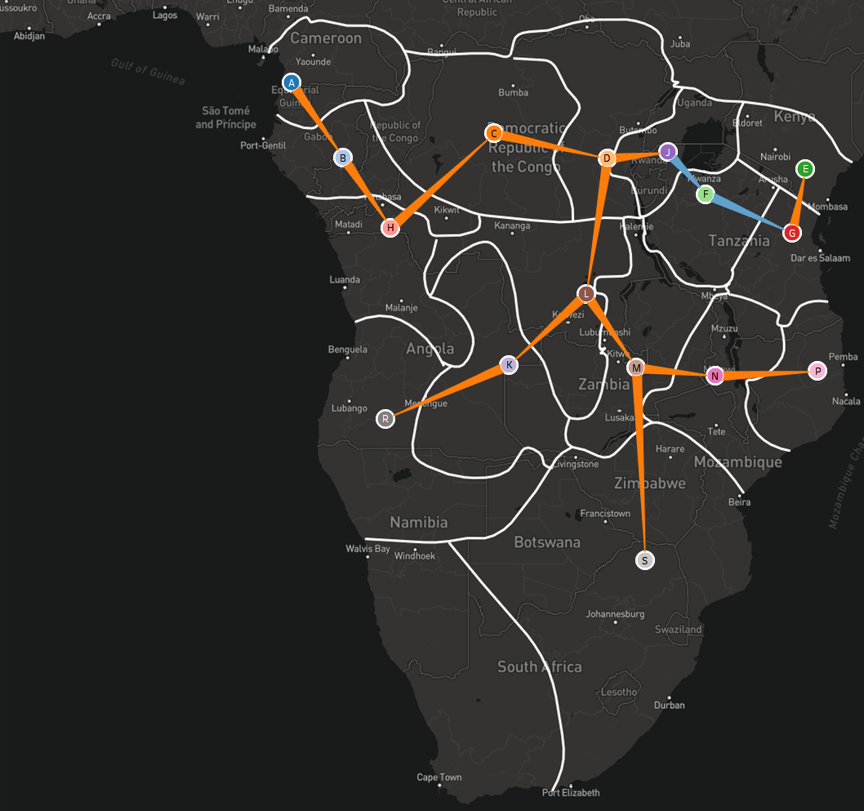
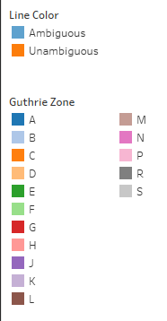

Slide 10
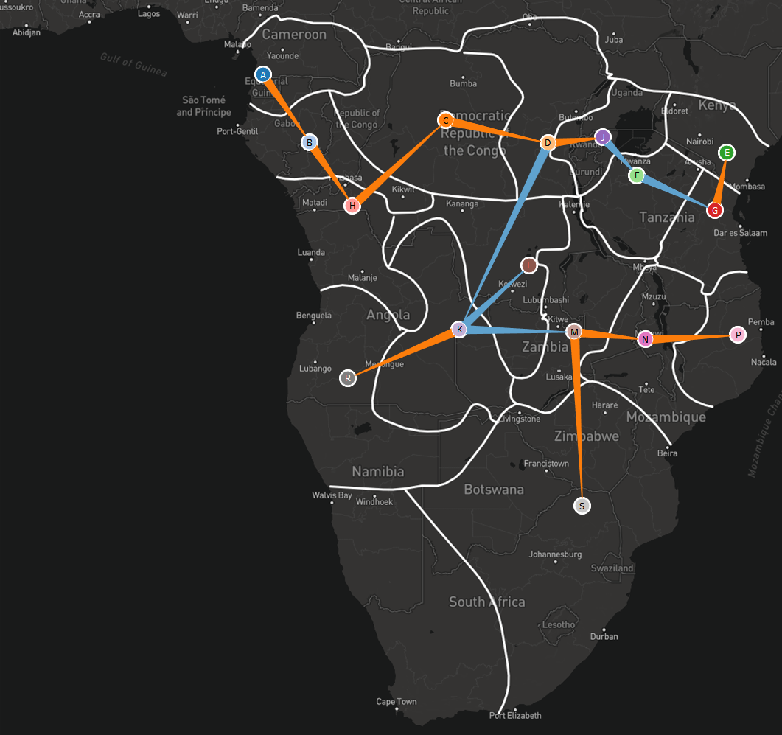

Slide 11
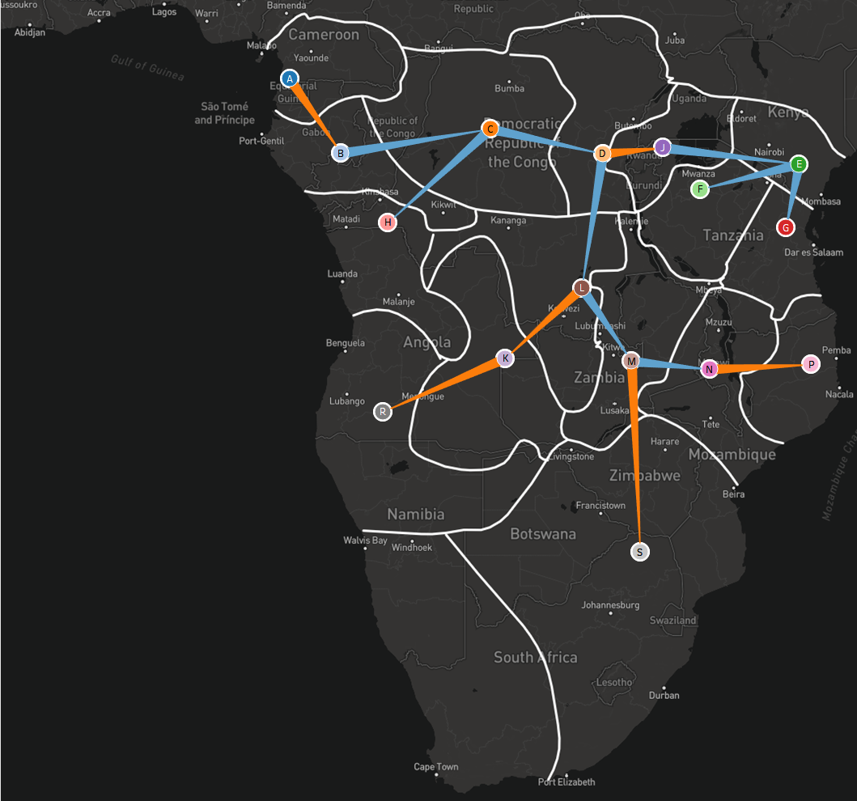

Slide 12
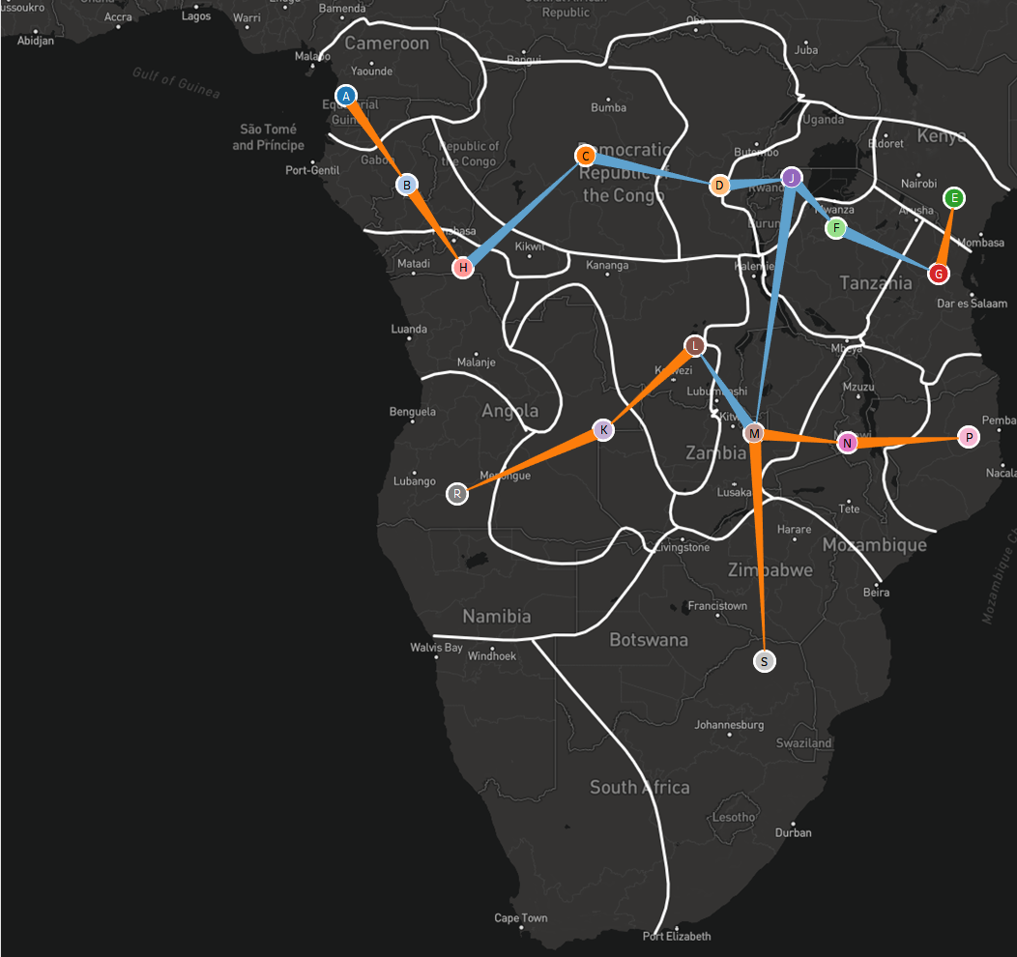

Slide 13
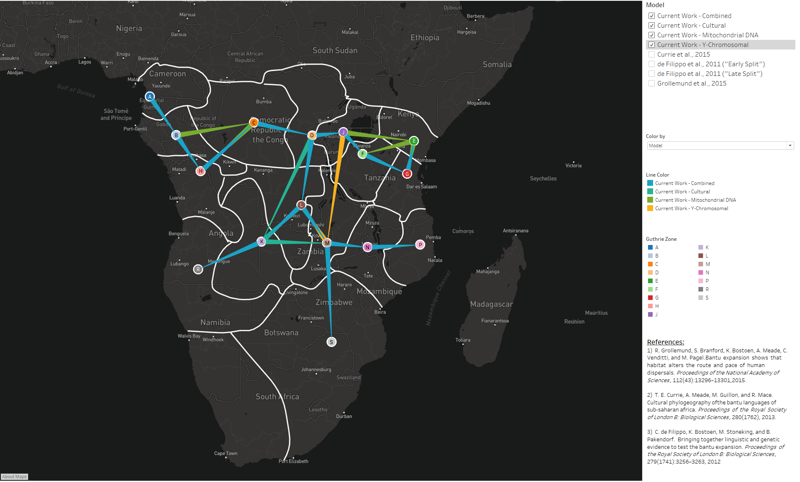

Slide 14
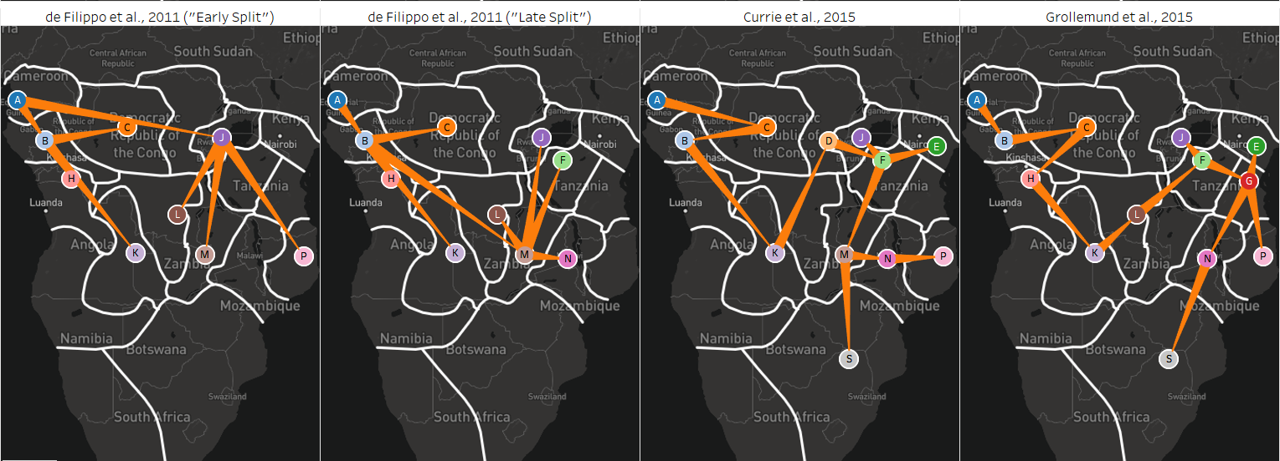
(a)
(b)
(c)
(d)

Slide 15
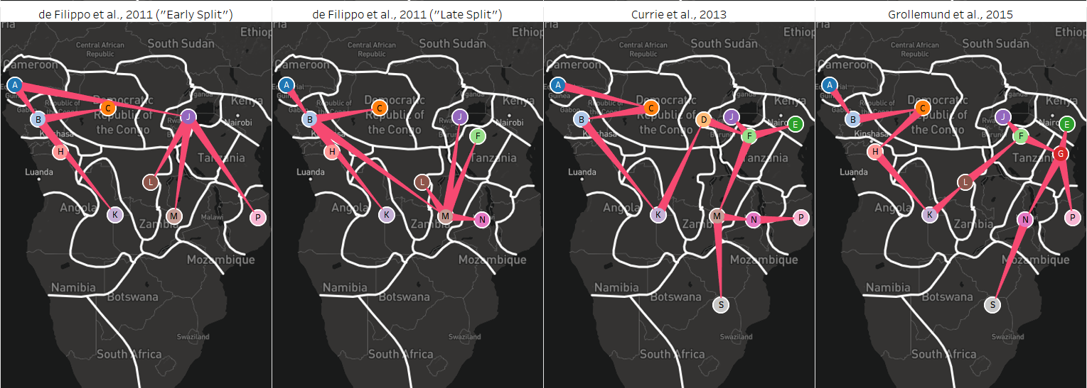
(a)
(b)
(c)
(d)

